Slide 1
WOMEN SAFETY APPLICATION

Slide 2
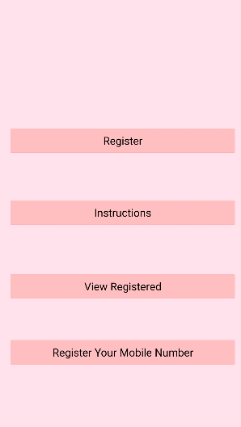
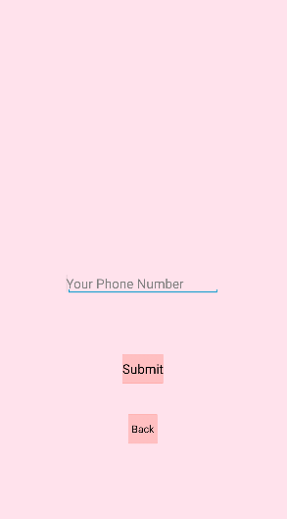
Main Menu
Registration Process

Slide 3
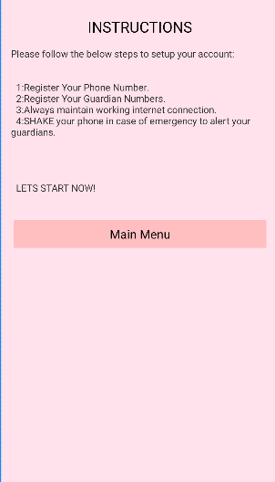
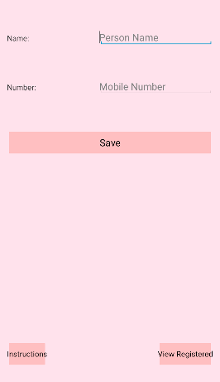
Instructions/necessary steps to be followed during an emergency

Slide 4
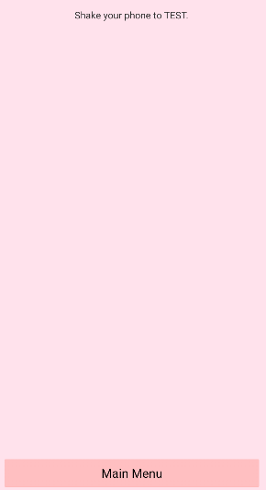
Finally shake your phone in case of emergency to notify the guardians

